Slide 2
Game Design & Development WS17/18 Prototype TEAM_CK

Slide 3
Contents
Introduction
Plan changes
User Interface
Mechanics
Player movement
Movement speed
Algorithm(s)
Prefabs
First algorithm
Perspective
Optimization

Slide 4
Introduction
Jump n Run game
procedurally generated map
main focus is generating the map
Notes:
As a little reminder
we are developing a jump n run game with a procedurally map (which is our main focus)

Slide 5
Plan changes
main focus is still generating the map
more than only one algorithm to generate the map
possibility to choose an algorithm
Notes:
Our original plan changed a bit but our main focus is still procedurally generating the map.
BUT:
if everything works out as expected, we will have more than one algorithm to choose from before you start the game.

Slide 6
Plan changes
not discarded but, even less priority than before:
enemies
collectibles
graphics (including map-settings)
Notes:
This means that there are some things that now have an even lower priority as before.

Slide 7
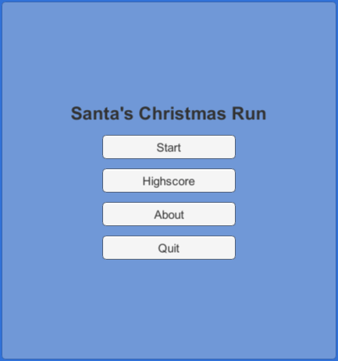
User Interface
main menu
Notes:
When starting the game you will see this main menu
Start will load the map-scene
Highscore is not implemented yet
About enables a canvas which shows some information about this project
Quit should close the game, but is also not implemented yet

Slide 8
Mechanics
Notes:
Our next topic is the perspective of santa´s christmas run.
And what we have planed to implement in the next development cycle.

Slide 9
Mechanics – Player movement
Space to jump
A / LeftArrow to move to the left
D / RightArrow to move to the right
speed depends on camera speed (3.5f), but is slightly faster (1.2 * cameraSpeed)
Notes:
As we mentioned in the last presentation, you can move by pressing Space to jump, A/LeftArrow to move to the right and D/RightArrow to move to the right
The speed of our player depends on how fast the camera is
To make the player move slightly faster than the camera the players movement speed is defined as cameraSpeed multiplied by 1.2

Slide 10
Mechanics – Camera movement
starts moving as soon as the player presses A/LeftArrow or D/RightArrow
continues to move even if the player stands still
starting with speed value 3.5f, will be increased based on score
Notes:
The camera is not moving when you start the game
It will start moving as soon as you move (except jumping)
It will continue moving even if your character stops moving
to make the game more difficult over time, we want to increase the camera speed depeding on how high your score is (this also increases the player speed)

Slide 11
Algorithm(s)
Prefabs
First Algorithm
Notes:
Now i am going to talk about our algorithm.
We have two topics to talk about.
prefabs
first algorithm

Slide 12
Which platforms do we need?
Notes:
Which platforms do we need to spawn and do they fulfil our requirements.

Slide 13
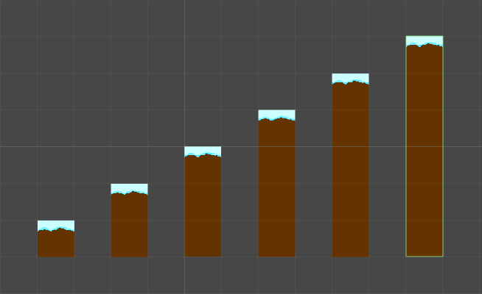
Notes:
We came up with this platforms.
But why?

Slide 14
Larger platforms can be constructed out of our platforms
1x1 platform to create hovering platforms
Notes:
We just need to place 3 1x3 platforms to create a 3x3 platform
-> very flexible
Same goes for hovering platforms, we can use the 1x1 for creating single blocks to increase the difficulty,
but also creating larger hovering platforms.
!!!(hovering platforms are not implemented yet).

Slide 15
Algorithm

Slide 16
random number from 0 to 6
For value 0-3 spawning next to the previous platform
For values 4 and 5 spawning with a gap
Notes:
This helps us to balance the game.
We want to increase the replayability.
The customer should enjoy the game and have a pleasant experience.
We don´t want to annoy the customer.

Slide 17
2. Selecting the next platform
Store the last used platform
Depending on the platforms height we randomly choose our next platform
Notes:
We store the last used platform and use ist height to determine which platform can be spawned next.
If we would spawn completly random, than it would be possible to create unscalable obstacles.

Slide 18
3. Choose the gap width
Random number between 2 and 4.2
Notes:
Tested different values and came up with this range.

Slide 19
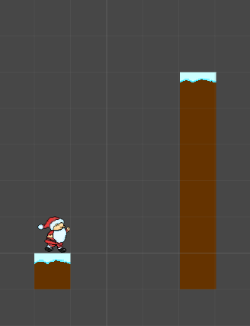
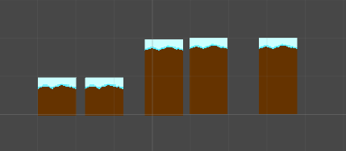
Notes:
Here you can see two problems, that we are trying to avoid with our algorithm.

Slide 20
Perspective
Notes:
Our next topic is the perspective of santa´s christmas run.
And what we have planed to implement in the next development cycle.

Slide 21
Optimization
Currently
Creating and destroying platforms
High resource consumption
Notes:
This costs more resources, than it could be.

Slide 22
Future
Optimization pattern called Object Pool
Reusing created platforms
Disabling platforms instead of destroying
Activating platforms instead of creating new ones
Notes:
Gives us a better performance, because we use already created objects.
We have to combine it with our algorithm, therefore we need to create an interface.
The algorithm does not have an dependencie to the object pool.

